Slide 1
MOVIE RECOMMENDATION SYSTEM
by VRISHANK WARRIER & VEDIKA SURVE
roll no. 16014022096 and 16014022084

Slide 2
Table of Contents :
1. Introduction
2. PEAS
3. Features
knowledgebase
Inference Engine Functions and Utility Functions
User Interface
4. Usage Example
5. Conclusion

Slide 3
Introduction :
Users frequently struggle to find movies that match their preferences among a vast array of options. To address this challenge, we've developed an expert system for personalized movie recommendations. Our system saves time and minimizes frustration by offering accurate suggestions tailored to individual tastes.

Slide 4
Introduction :
PROBLEM STATEMENT:
Develop an intelligent movie recommendation system that offers personalized movie suggestions based on user preferences such as genre and favorite cast members. The system should provide accurate and enjoyable recommendations, enhancing the overall movie-watching experience for users.

Slide 5
Introduction :
OBJECTIVE:
The objective of this project is to design and implement an intelligent movie recommendation system that provides personalized movie suggestions to users based on their genre preferences, favorite actors, and similar movies they enjoy.

Slide 6
PEAS :
Performance
Environment
generate personalized movie recommendations based on user input
execution time
accuracy of recommendations
responsiveness
VSCode and Python,
laptop with adequate processing power and memory.
fuzzywuzzy module.
Actuators
Sensors
monitor
console
keyboard
mouse

Slide 7
Expert Systems :
REPRESENTATION :
Rule-based representation
Fuzzy logic

Slide 8
Expert Systems :
Features :
Knowledge Base
Inference Engine
User Interface
Explanation Facility
Learning and Update

Slide 9
Features :
KNOWLEDGE BASE :
Data Structures Used:
List
Dictionary

Slide 10
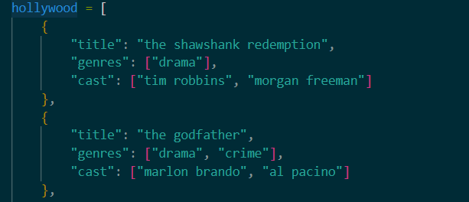
Features :
KNOWLEDGE BASE :
Data Structures Used:
List
Dictionary
Categories :
Hollywood Movies
code snippet for Hollywood:

Slide 11
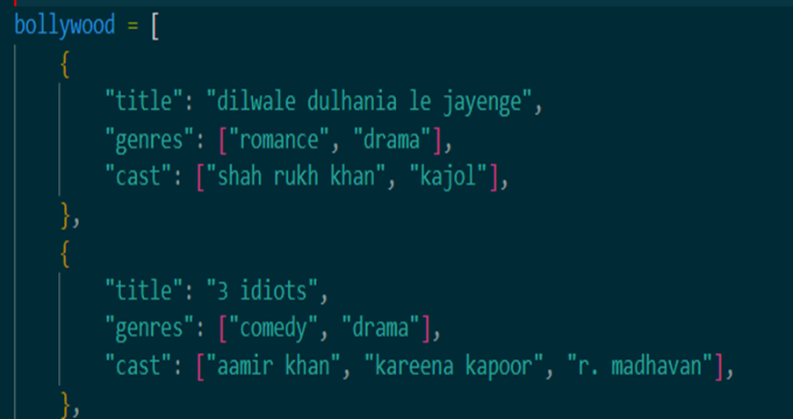
Features :
KNOWLEDGE BASE :
Data Structures Used:
List
Dictionary
Categories :
Hollywood Movies
Bollywood Movies
code snippet for Bollywood:

Slide 12
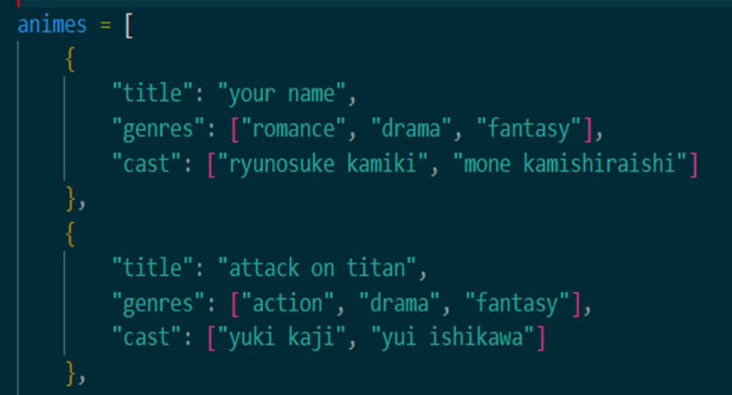
Features :
KNOWLEDGE BASE :
Data Structures Used:
List
Dictionary
Categories :
Hollywood Movies
Bollywood Movies
Anime
code snippet for Anime:

Slide 13
Features :
INFERENCE ENGINE :
Functions of the Inference Engine
Utility Functions
Integration with User Interface

Slide 14
Features :
INFERENCE ENGINE :
Functions of the Inference Engine
Recommend by Genre

Slide 15
Features :
INFERENCE ENGINE :
Functions of the Inference Engine
Recommend by Cast

Slide 16
Features :
INFERENCE ENGINE :
Functions of the Inference Engine
Recommend by Genre and Cast

Slide 17
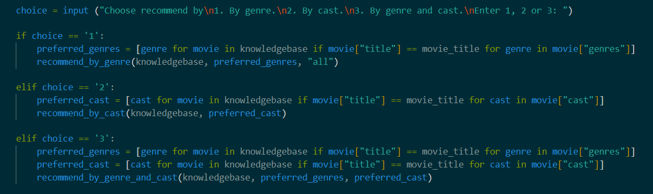
Features :
INFERENCE ENGINE :
Functions of the Inference Engine
Recommend by Similar Movie Title

Slide 18
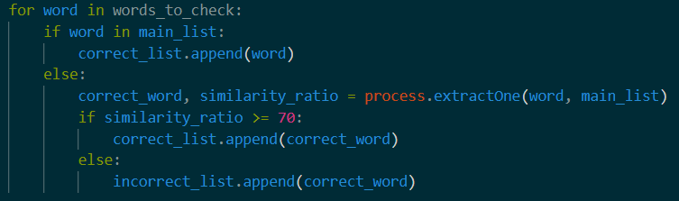
Features :
INFERENCE ENGINE :
UTILITY FUNCTIONS
Spelling Checker for Genre and Cast

Slide 19
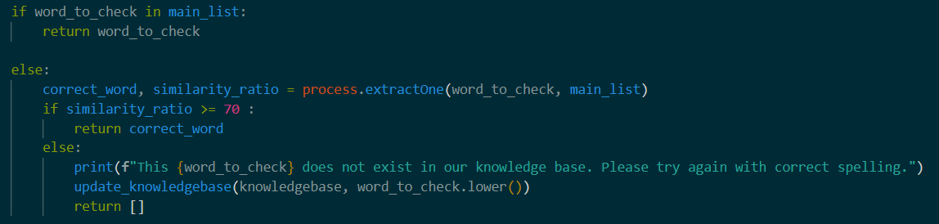
Features :
INFERENCE ENGINE :
UTILITY FUNCTIONS
Spelling Checker for Movie Title

Slide 20
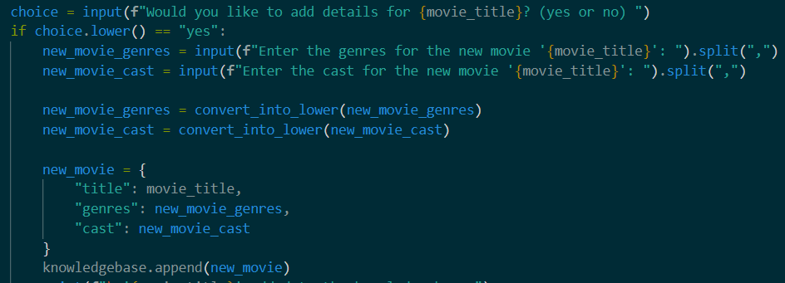
Features :
INFERENCE ENGINE :
UTILITY FUNCTIONS
Update knowledgebase

Slide 21
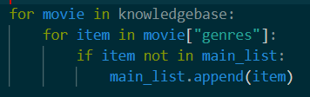
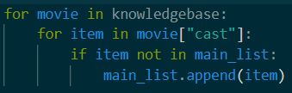
Features :
INFERENCE ENGINE :
UTILITY FUNCTIONS
list of genre, cast and movie title

Slide 22
Features :
USER INTERFACE :
User Interaction Flow
Knowledge Base selection
Input preference
Recommendation type selection
View Recommendation
Update Preferences
Error Handling

Slide 23
Code:
Knowledge base :
Inference engine :
Utility function :
User Interface :
Google collab link :
https://colab.research.google.com/drive/1lgQoiI6cFf2wFYVZoZ2Gzo1wkaxM5ORV?usp=sharing

Slide 24
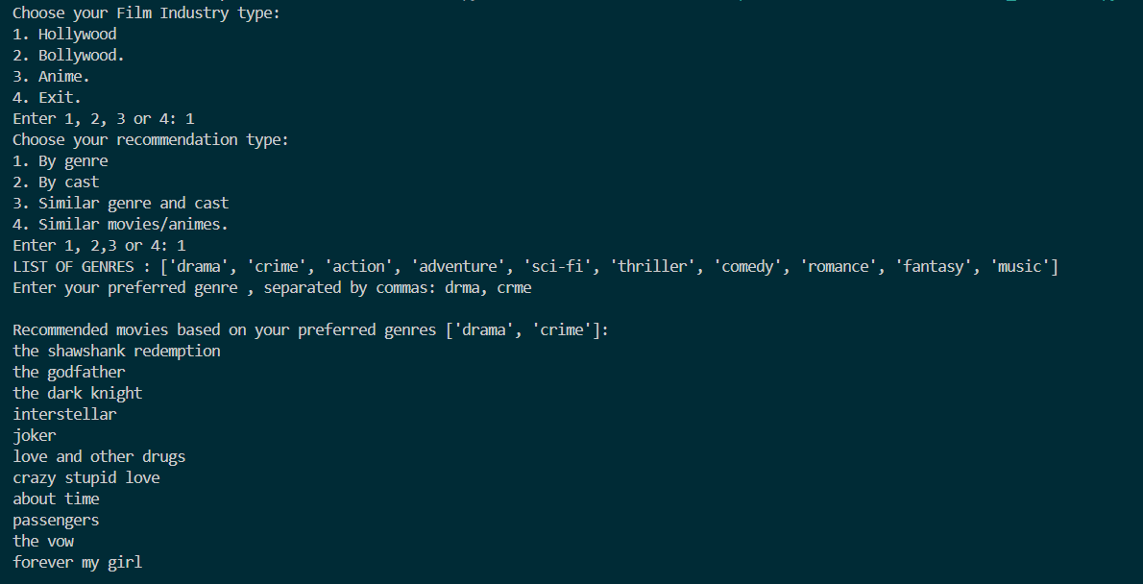
Usage:

Slide 25
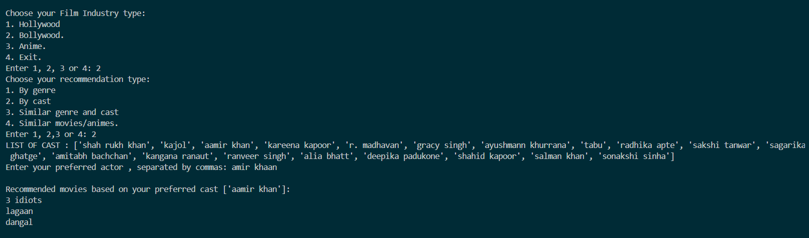
Usage:

Slide 26
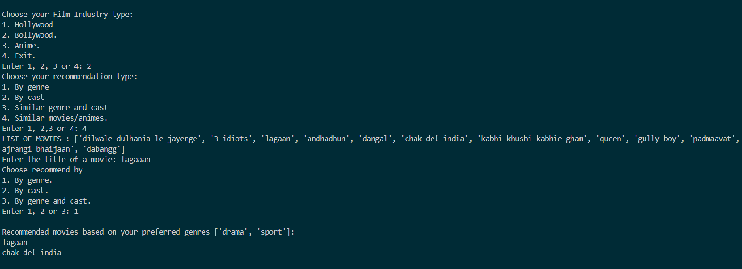
Usage:

Slide 27
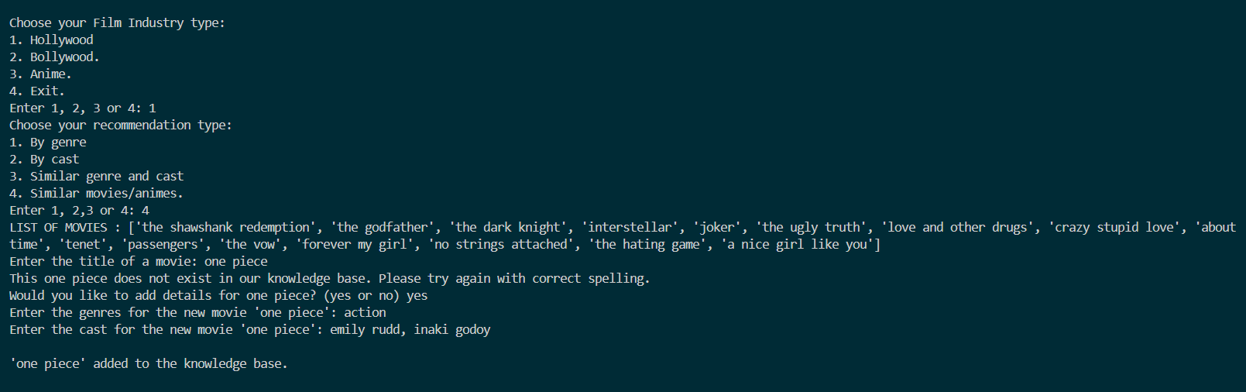
Usage:

Slide 28
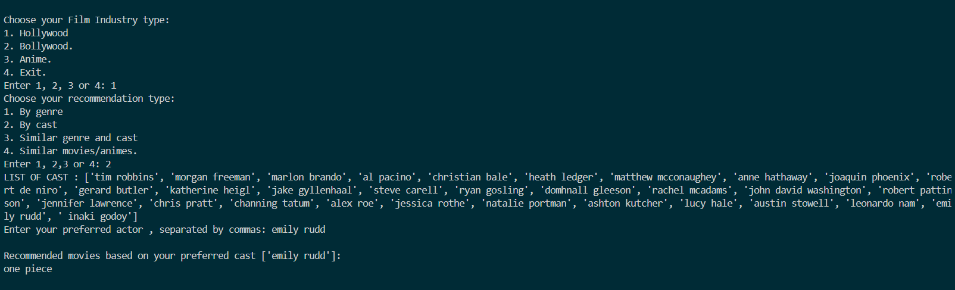
Usage:

Slide 29
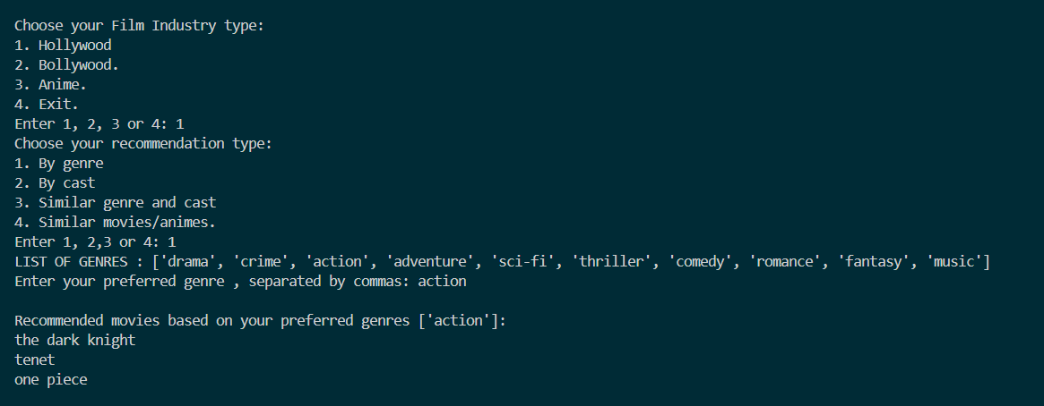
Usage:

Slide 30
Conclusion :
Our movie recommendation system delivers personalized suggestions based on user preferences, enhancing the movie-watching experience.
By allowing users to input their preferences for genres and favorite cast members, the system generates tailored recommendations that match their interests.
With intuitive interfaces and interactive features, it ensures accurate and enjoyable recommendations, saving time and boosting user satisfaction.

Slide 31



Reference :
Research
Link
The movie recommendation system was inspired by the article "How to Build a Movie Recommendation System" from Towards Data Science.
The reference article can be found at the following link: https://towardsdatascience.com/how-to-build-a-movie-recommendation-system-67e321339109
Knowledge base
Link
The knowledge base was taken from
imdb website and google search engines
https://www.imdb.com/

Slide 32
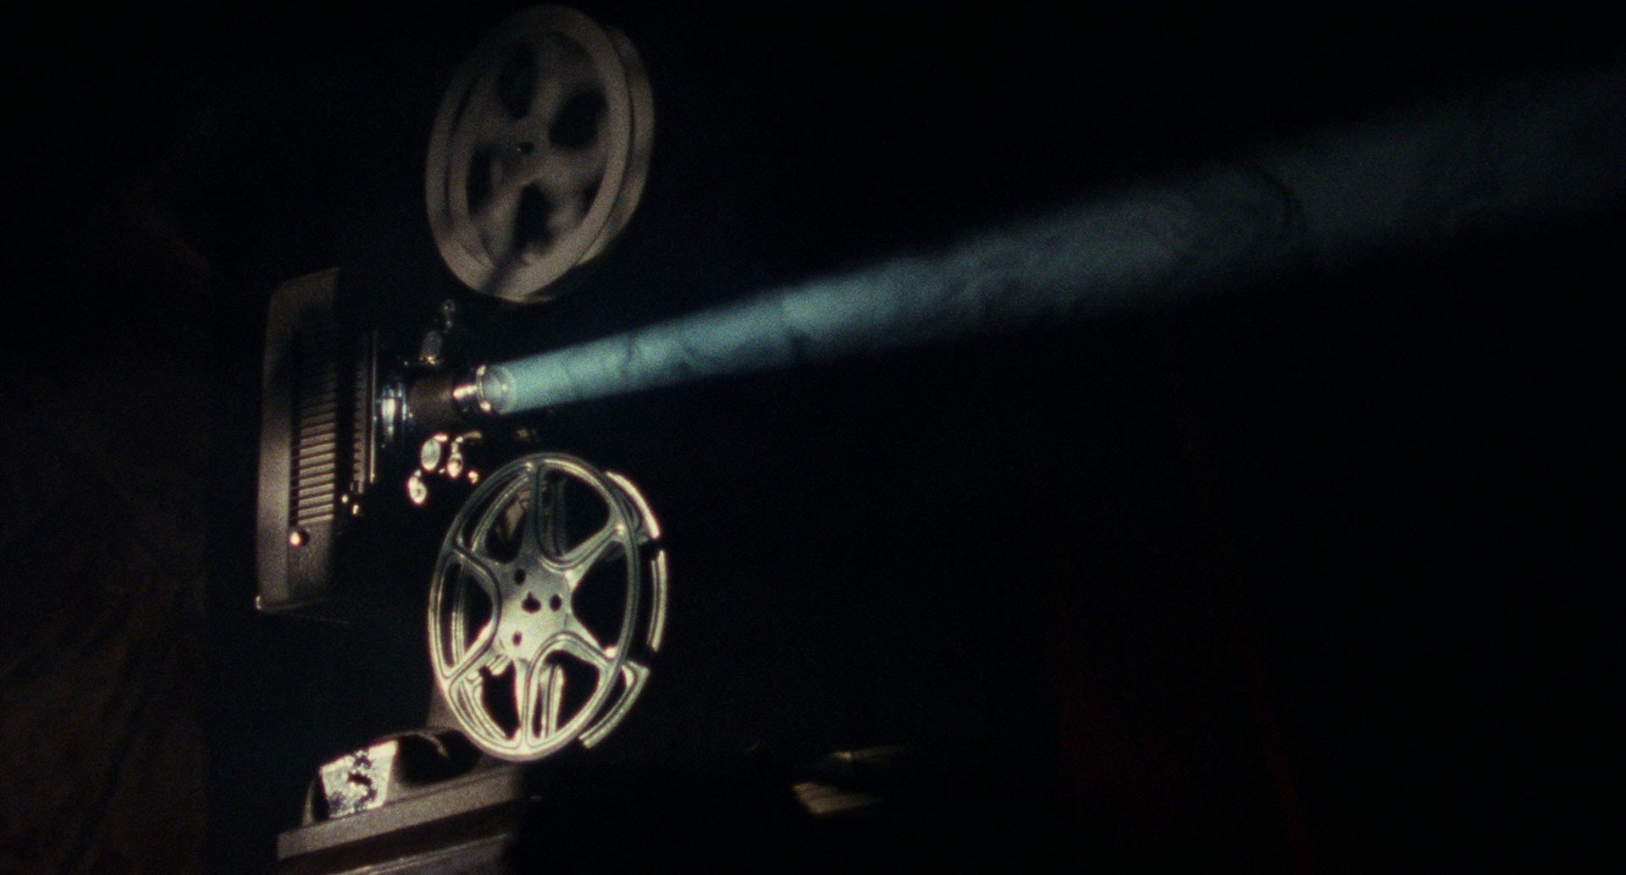
THANK YOU

